Slide 1
Single Source Shortest Path (Dijkstra Algorithm)
By: Abdel Rahman Nader

Slide 2
Strategy
Dijkstra’s Algorithm is a Greedy Algorithm which as the name entails searches for the best current option. This is its biggest advantage and disadvantage as it may disregard the optimal solution for immediate gains depending on the problem.

Slide 3
Dijkstra’s algorithm
For Dijkstra’ algorithm its downfall can be summarized in two words : negative values. When presented with negative values, the algorithm takes the least values which can make it take a longer route as the values will not represent the actual route.

Slide 4
The Upsides
Many real life problems can be tackled with this algorithm such as finding the shortest route between two points . Whether it’s the distance between two points on a Map (google maps) or finding the shortest route to each node in IP routing the algorithm has proven to work astoundingly.

Slide 5
Following the Strategy
First of all, lets think about the problem. We have N nodes that represent a graph and we need to get to the end in the least cost possible. To do that we will take the currently available path with the least cost ahead of us and if the if the path to the current node is less than the previous cost update it.

Slide 6
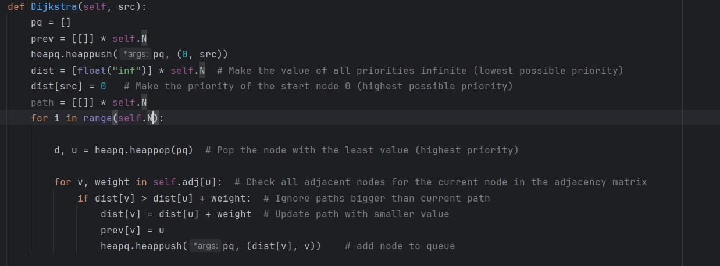
Implementation

Slide 7
Implementation (cont.)
The slide before displays the full implementation but how did we reach that point?
First, as mentioned before we always need the least cost available to do that we can utilize the priority queue which as the value is reduced the priority rises.
We will loop N times since each Node will be visited one time only (not counting the adjacent comparison)
we pop the node with highest priority
iterate over the neighbors and check if the current cost of the neighbor is more than the cost to the current node plus the cost of movement. If yes then change the neighbor cost to the current plus the cost and push the neighbor to the queue.
Rinse and repeat till loop finishes

Slide 8
Data-structures used
There are different ways to implement this algorithm although all share the same general structure.
In my implementation I will be representing the graph with an undirected adjacency list , additionally I will be using a priority queue(python’s priority queue utilizes the min-heap) to queue the nodes yet to be explored. Lastly I will use a list to save the values of least cost for each node with each value except the start initialized with infinity.

Slide 9
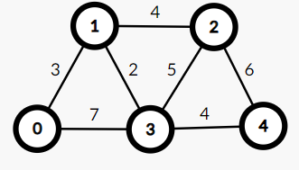
Visualization
Now lets apply on an example.

Slide 10
Visualization
First lets initialize our queue and cost array
Queue: (0,cost:0)
min-cost: 0/ inf / inf / inf / inf

Slide 11
Visualization
First lets initialize our queue and cost array
Queue: (1,cost:3),(3,cost:7)
min-cost: 0/ 3 / inf / 7 / inf

Slide 12
Visualization
First lets initialize our queue and cost array
Queue: (3,cost:5),(2,cost:7),(3,cost:7)
min-cost: 0/ 3 / 7 / 5 / inf

Slide 13
Visualization
First lets initialize our queue and cost array
Queue: (2,cost:7),(3,cost:7),(4,cost:9),(2,cost:10)
min-cost: 0/ 3 / 7 / 5 / 9

Slide 14
Visualization
First lets initialize our queue and cost array
Queue: (3,cost:7),(4,cost:9),(2,cost:10)
min-cost: 0/ 3 / 7 / 5 / 9

Slide 15
Visualization
First lets initialize our queue and cost array
Queue: (4,cost:9),(2,cost:10)
min-cost: 0/ 3 / 7 / 5 / 9

Slide 16
Visualization
First lets initialize our queue and cost array
Queue:
min-cost: 0/ 3 / 7 / 5 / 9

Slide 17
Visualization
final minimum costs =[ 0/ 3 / 7 / 5 / 9]

